Slide 1


Hong Kong Monetary Authority
Team Mailbox Assistant – AS2 Technology Showcase
Oscar Lam & Pandora Chow Dec 2025
Notes:
1

Slide 2
Agenda
Background
Live Demo
Solution Features
Future Roadmap
Technology Stack
Q&A

Slide 3
Background

Slide 4

Background
High volumes of emails in Team Mailbox
Team mailbox receives hundreds of emails a day
User spend time reading and assigning emails to owners for follow up
Different kinds of emails will be received
Some emails are spams or irrelevant

Slide 5

Background
Limitations of Outlook’s rule‑based categorisation
Only rules based on keywords/properties can be set
Cannot read through context to determine a better category
Complex to construct a new rule
User have to specify values in rules (name/dates/text …etc)

Slide 6

Background
Management-level needs
All IT teams: frequency and trends of recurring alert types
Helpdesk: frequency and distribution of request types and common questions
Lack of reporting and analytics to show an overview of the function

Slide 7
Solution Features

Slide 8
Features
01
02
03
Summarisation
Categorisation
Custom Configuration
Generate batch summaries of incoming emails (Insights layer)
Categorise and move incoming emails to mailbox folders (Action layer).
Function and prompts configuration

Slide 9



Role-based management
Senior level | Team lead level | Working level
Dashboard for overall email statistics | Frequency of types that teams received
 | Allocation of emails into mailbox folders for task distribution | View of allocated emails (Both in Outlook & SPARK)
Summarisation
Categorisation
Notes:
6

Slide 10
Technology Stack

Slide 11
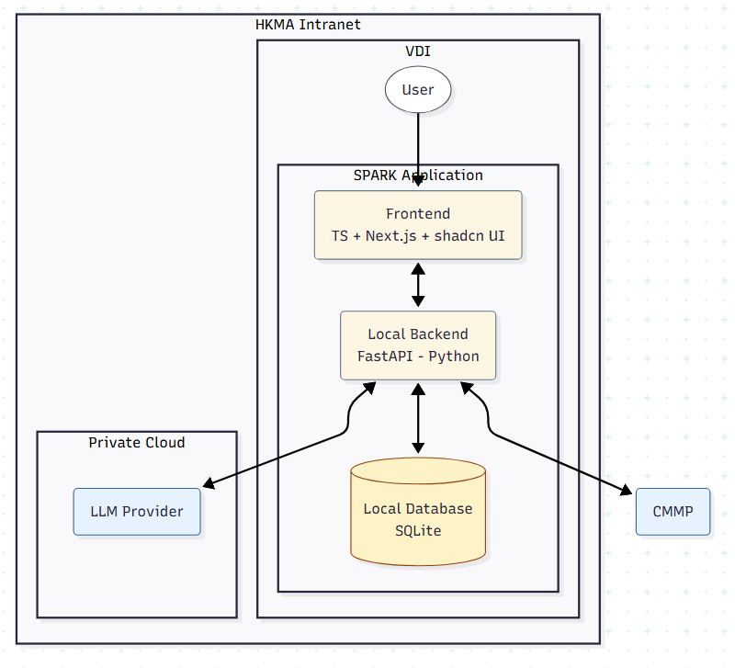
Technology Stack
Highlights:
Keep external infrastructure minimal
CMMP
LLM Provider
Standalone application
Packaged as executable
Secure deployment
Runs on local VDI
Emails are passed to MaaS

Slide 12
Peer Analysis

Slide 13
Peer Analysis
SPARK | Outlook | NOVA | Dify
Local | Local | Server based | Server based
Standalone application | Standalone application | Office Add-In | Web application
AI Capability
CMMP Connection
Network
Deployment

Slide 14
Live Demo
Notes:
8

Slide 15


Future roadmap
Workflow Integration
Delivery to teams for feedback
Integration with SLM
TPG

Slide 16
Q & A
Notes:
9

Slide 17

Thank you

